Slide 1
OCR for Camera based handled Devices
EE604A Project Presentation
Group 15 Members :
Arvind Kumar Meena (13152)
Maneesh Kumar Meena (13381
Instructor : Prof. Tanaya Guha Tutor : Saurabh

Slide 2
Motivation
Our Purpose is to make an editable document from an scaned or photo text image.
Its easy to make softcopy of document from hardcopy with less effort and without wasting time.
OCR is used in smartphones and another devices.

Slide 3
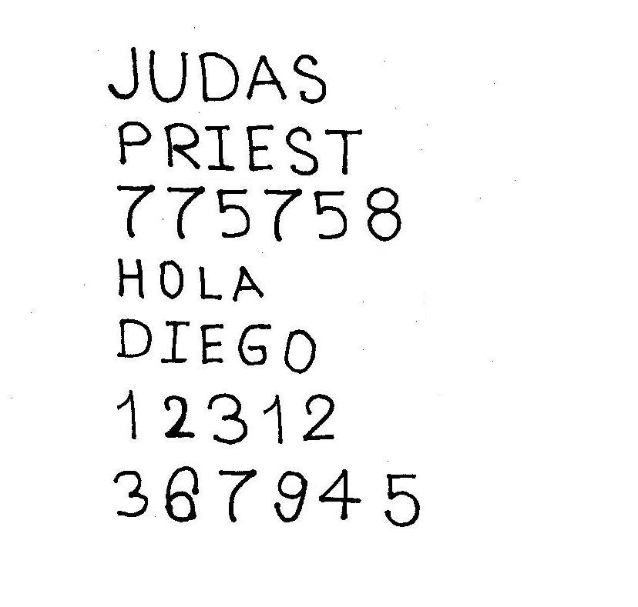
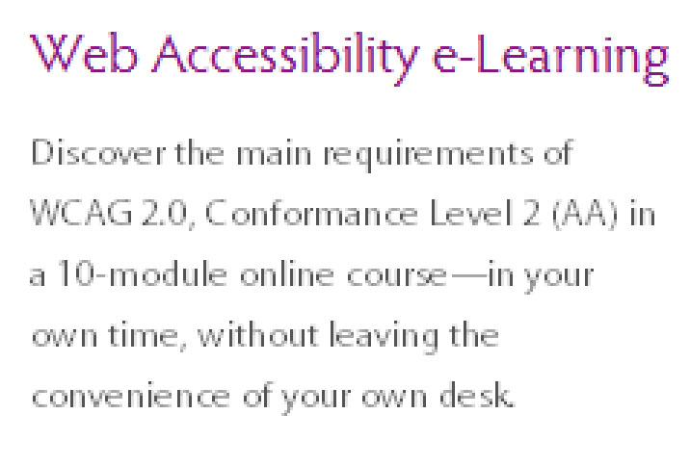
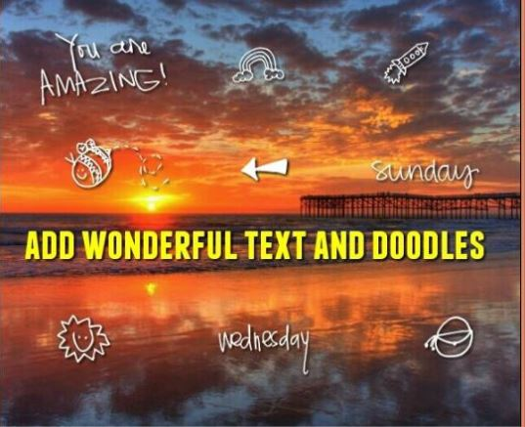
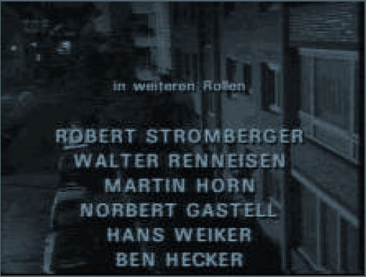
Problem Statement
Design an app that extract and recognise text from an Image and from it make a text document.
Image can have Different background information
Hand Written Text Discontinuous Text Image with Background Blured & complicated
Notes:
Collaboration in E-business tech

Slide 4
Approach
Image
Text Extraction
Skew Correction
Binarization
Editable Document
Recognisation
Segmentation
Notes:
Collaboration in E-business tech

Slide 5
Implementation
EEH Text Detector -
begin Binarization :
for all pixels (x,y) in Image begin
take max {(x,y)-(x-1,y),(x,y)-(x,y-1),(x,y)-(x-1,y+1) } for all pixels (x, y) in image
end for if intensity(x, y) < threshold, then
for all pixels remove all non connected pixels (x, y) is background
end for else
img= dilate( img,rect [2 ,5]) (x, y) is foreground
for all pixels (x,y) in img end if
if img(x,y)<threshold end for
image(x,y)=0 end
end if
Binarization
Text Extraction
Segmentation
OCR
Text Document
Notes:
Electronic marketplaces

Slide 6
Implementation
2. MSE Text Detector
Extra Algoriths to compare result
1. MSER 2. TRD text detector
.
Extract Text Region:
for all object in binarize image
if min < minor & major axis of object < max
keep object
else remove it
end if
if min < area of object < max
keep object
else remove it
end if
end for
OCR Based on Templete matcing
in Text extracted image
for all object in image
resize object size to templte image
for all template image
calculate norm matching error
take minimum norm error text image
put a corresponding letter in file
end for
end for
end
Notes:
To understand these issues (timely delivery of good and services ) -SCM distinguishes b/w 3 level

Slide 7
Results
Image Type/ text detectors | OCR | EEH | MSE | MSER
Hand Written
Discontinuous text | 0.5608 | 0.7878 | -
Background image | 0.0379 | 0.9240 | -
Blur and complicated | 0.0000 | 0.9342 | -

Slide 8
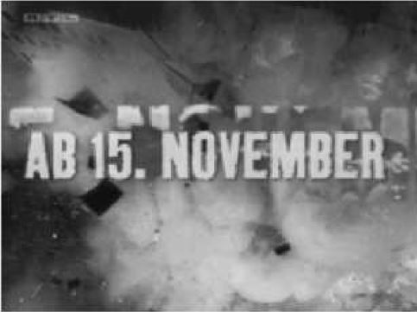

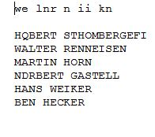
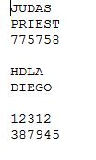
Results

Slide 9
Contribution
We took MSER Text Detecter from Internet resource (matlab Official ) just to compare results.(mentioned in references)
All other code are our own. We haven’t used any Internet resource or prewritten code.
We didn’t use any matlab special inbuilt function.
We used sample images from internet randomly and we create our own data sets of images to collect results.

Slide 10
References
Ayatullah Faruk Mollah, Subhadip Basu, and Mita Nasipuri,”Design of an Optical Character Recognition System for Camera-based Handheld Devices “ .( Research Paper from www.reasearchgate.net )
2. Line Eikvil ,”Optical Character Recognition”, December 1993
MSER Algorithm Link : https://in.mathworks.com/help/vision/examples/automatically-
detect-and-recognize-text-in-natural-images.html

Slide 11
-Thank You

